Slide 1
Automated Hate Speech Detection in Online Group Chat Platforms
by:
Meet Saini

Slide 2
Introduction
Any statement or speech that expresses prejudice or animosity toward someone because of their race, colour, sexual orientation, religion, ethnicity, or other characteristics is considered hate speech.
Consequences of Hate Speech:
Psychological Impact on Individuals
Social and Community Consequences
Impact on Organizations and Online Platforms

Slide 3
Business Problem
Problem Statement:
The rise of anonymous online group chat rooms has provided a space for free and open communication.
However, these platforms are also prone to misuse, including the spread of hate speech.
The business problem we are addressing is the need for an effective mechanism to automatically detect and mitigate hate speech in these chat rooms, ensuring a safer and more welcoming environment for all users.
Solution Description:
The proposed solution for detecting and mitigating hate speech in online group chat platforms involves developing a deep learning model using a Bidirectional Long Short-Term Memory (LSTM) network with GloVe embeddings.

Slide 4
Solution Description
Solution Description : To address the problem of hate speech on Online platform, we propose developing a machine learning model that can automatically detect and categorize user-generated content into hate speech/offensive language and neutral content

Slide 5
Dataset Description
Datasets Considered:
Cyberbullying Data from Formspring.me
Toxic Comment Classification Challenge Dataset
ConvAbuse Dataset
Final Dataset:
The final dataset is a combination of both Cyberbullying Data from Formspring.me and ConvAbuse Datasets. Because-
Formspring is a site where people can chat anonymously about each other and the dataset contains instances of cyberbullying, which is a subset of hate speech, annotated for bullying and offensive content.
The ConAbuse dataset provided with a large number of texts with various labels like is_abuse, racist, sexism, generalized and various texts have been collected by various chatbots from chats.
Dataset: https://drive.google.com/file/d/1tA_JHor89JwksdtKA4AeOvGPoHeG2D3m/view?usp=sharing

Slide 6
Dataset Description (Contd..)
Dataset Characteristics:
The dataset consists of 2 Columns:
Text: The text message.
Label: The label indicating whether the text is hate speech (1) or not (0).
Size of the dataset: 17,596
No. of columns: 2 - Text, Label
No. of records with label=1: 7,100
Percentage of hate records: 40.4%
Vocabulary Size: 22147

Slide 7
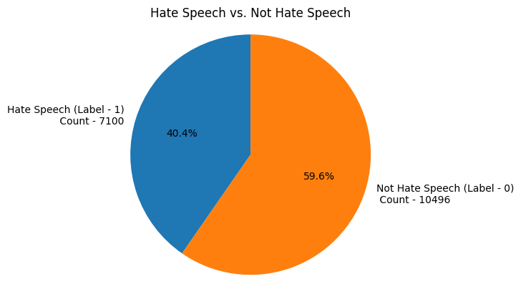
Data Visualization

Slide 8
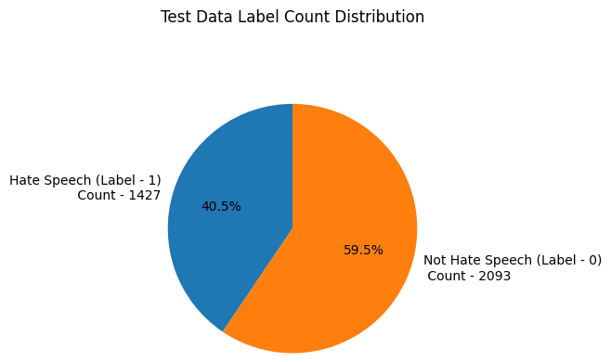
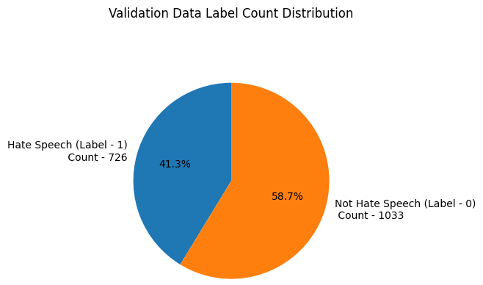
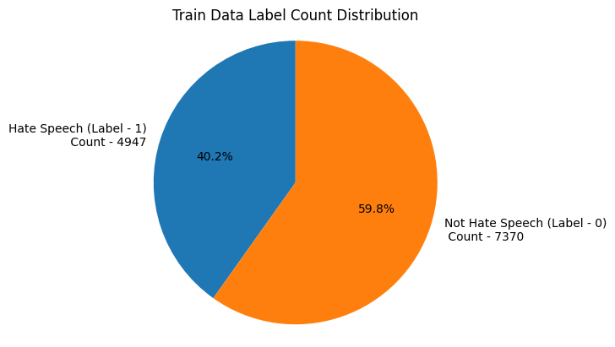
Data Visualization (Contd..)

Slide 9
Data Preprocessing
The first step in our hate speech detection model involves collecting and preprocessing the data. This step is crucial as the quality and cleanliness of the data significantly affect the model's performance.
Removing Extra Spaces: Normalize the spacing in the text to remove any extra spaces.
Removing usernames: Same as for the URL, a username in a text won’t give any valuable information because it won’t be recognized as a word carrying meaning. We will then remove it.
Removing Hashtags: Hashtags are hard to apprehend, but usually contain useful information about the context of a text and its content. So to utilize this we only remove the hashtag character(#) and the remaining word is preserved.
Handling Contractions: Handling contractions in text is an important step in text preprocessing where understanding the full meaning of the words is crucial. Contractions are shortened forms of words or combinations of words created by omitting certain letters and sounds (e.g., "don't" for "do not“).
Lowercasing: Convert all text to lowercase to ensure uniformity, as the model should treat "Hate" and "hate" as the same word.
Removing Punctuation: Strip out punctuation to focus on the words themselves.
Removing URLs: URLs do not give any information when we try to analyze text from words.
Removing Short words: Short words are the words whose length is less than three. Examples of this are - 'a', 'an', 'is' etc. Generally these words do not contain contextual meaning while detecting hate speech. Hence they can be removed.
Lemmatization: Lemmatization is the process of grouping together different inflected forms of the same word. The goal of lemmatization is to reduce a word to its root form, also called a lemma.

Slide 10
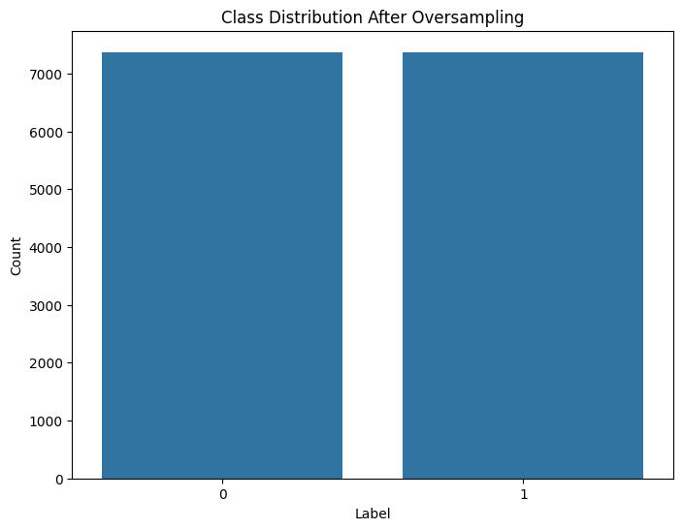
Handling Imbalances in training data:
After splitting the dataset into train, test and validation, we can observe that there is an imbalance in 'Label' column in the training dataset as we can see there are 4097 instances of label '0' where as there are only 7370 instances of label ‘1’.
This would significantly effect model training because models trained on this dataset might be biased towards the majority class (non-hate speech) and may not perform as well in identifying hate speech instances.
Resampling Training data using Random Oversampler:
Label Count
0 => 7370
1 => 7370

Slide 11
Tokenization and Embedding Techniques
Tokenization : Tokenization is the process of breaking down text into smaller units called tokens.
Word Tokenization - Word tokenization divides the text into individual words. In this tokenization technique, words are treated as the basic units of meaning.
Embedding: Embedding in the context of deep learning and natural language processing (NLP) is a way of representing words or phrases as dense vectors in a continuous vector space. These vectors capture semantic meanings and relationships between words.
One Hot Encoding
Term Frequency
TF-IDF
Word2Vec CBOW
Word2Vec Skip-Gram
GloVe

Slide 12
Tokenization and Embedding Techniques
Finalized Embedding Technique:
Using TF - IDF Embedding method for calculation of how relevant a word in a series or corpus is to a text.
TF-IDF advantages for text classification include capturing important words.
TF-IDF measures the importance of a term in a document, based on the frequency of the term in the document and the inverse document frequency (IDF) of the term across the entire corpus

Slide 13
Modeling
Machine Learning Models:
Naive Bayes Model
Logistic Regression Model
Support Vector Machines
Deep Learning Models:
Convolutional Neural Networks (CNN)
Recurrent Neural Networks (RNN)
Bidirectional Long Short Term Memory (LSTM) Model

Slide 14
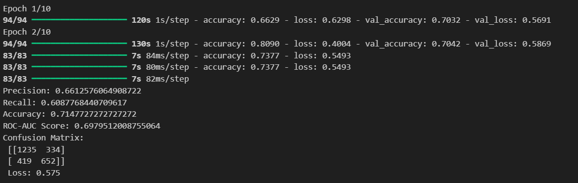
Modeling
Final Deep Learning Model:
Convolutional Neural Networks (CNN):
A convolutional neural network (CNN or ConvNet) is a network architecture for deep learning that learns directly from data.CNNs are particularly useful for finding patterns in images to recognize objects, classes, and categories. They can also be quite effective for classifying audio, time-series, and signal data.

Slide 15
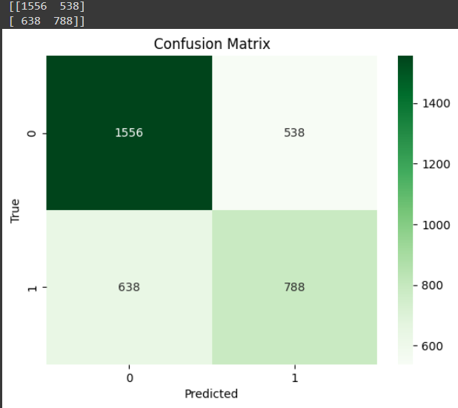
Model Training
The model is trained on X_train and y_train for up to 15 epochs. A batch size of 64 is used. The early_stopping callback is included to prevent overfitting. The validation data (X_val, y_val) is used to monitor the model's performance during training.

Slide 16
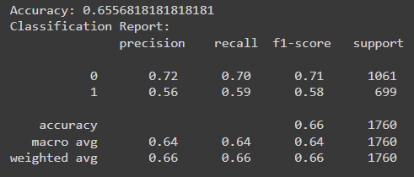
Classification Report

Slide 17
Thank You

